Slide 1



C-PIC Strategy
Introducing our overarching strategy and our six supporting strategies that work together to bring our vision to life

Slide 2
Our strategy
overarching strategy
scientific strategy
commercialisation strategy
Equality, Diversity and Inclusion (EDI) strategy
communications strategy
career development strategy
Responsible Research and Innovation (RRI) strategy
Overarching strategy
Vision: To make cutting-edge technology more open and available to improve daily life.
Mission: To build a pipeline of UK silicon photonics enabled companies serving multiple industry sectors by 2030, underpinned by our open-source silicon photonics foundry​.
We will achieve our mission using three core objectives:
Champion the use of silicon photonics and its community
Translate silicon photonics from research to industry
Cultivate a positive work culture
Six supporting strategies: underpin our approach to delivering on these core objectives.

Slide 3
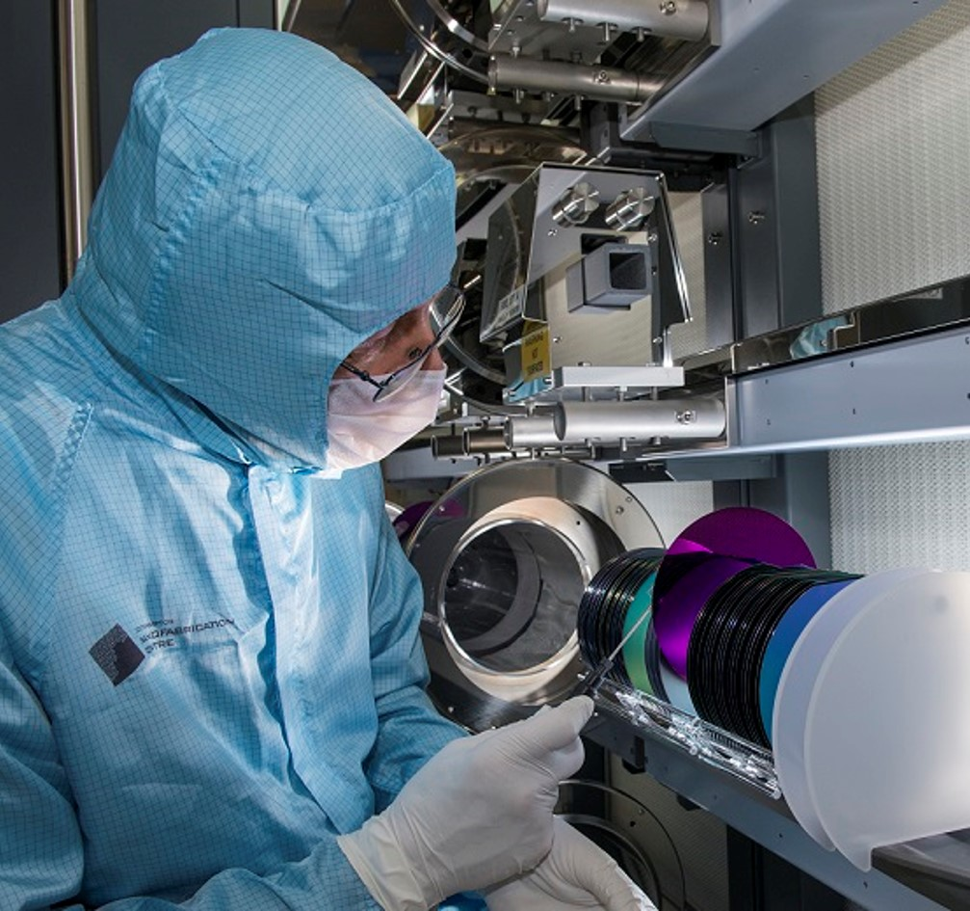



Scientific
Mission
To discover new technologies and functionalities that when coupled with our innovation ecosystem, can have transformative effects on daily life.
Vision: to generate scientific advancements that lead to commercially viable, socially responsible real-world applications
Aims
Establish PhD projects and recruit students
Contribute to developing technology roadmaps
Secure funding and investment from diverse sources
Become leaders in Open Data
Form partnerships in environmentally sustainable technologies
Approach
Focus on 5 key areas:
Government-defined Frontier Technologies and their convergence
Fostering interdisciplinary collaborations
Environmental sustainability and net zero
Systems-based approaches
Open-source principles

Slide 4
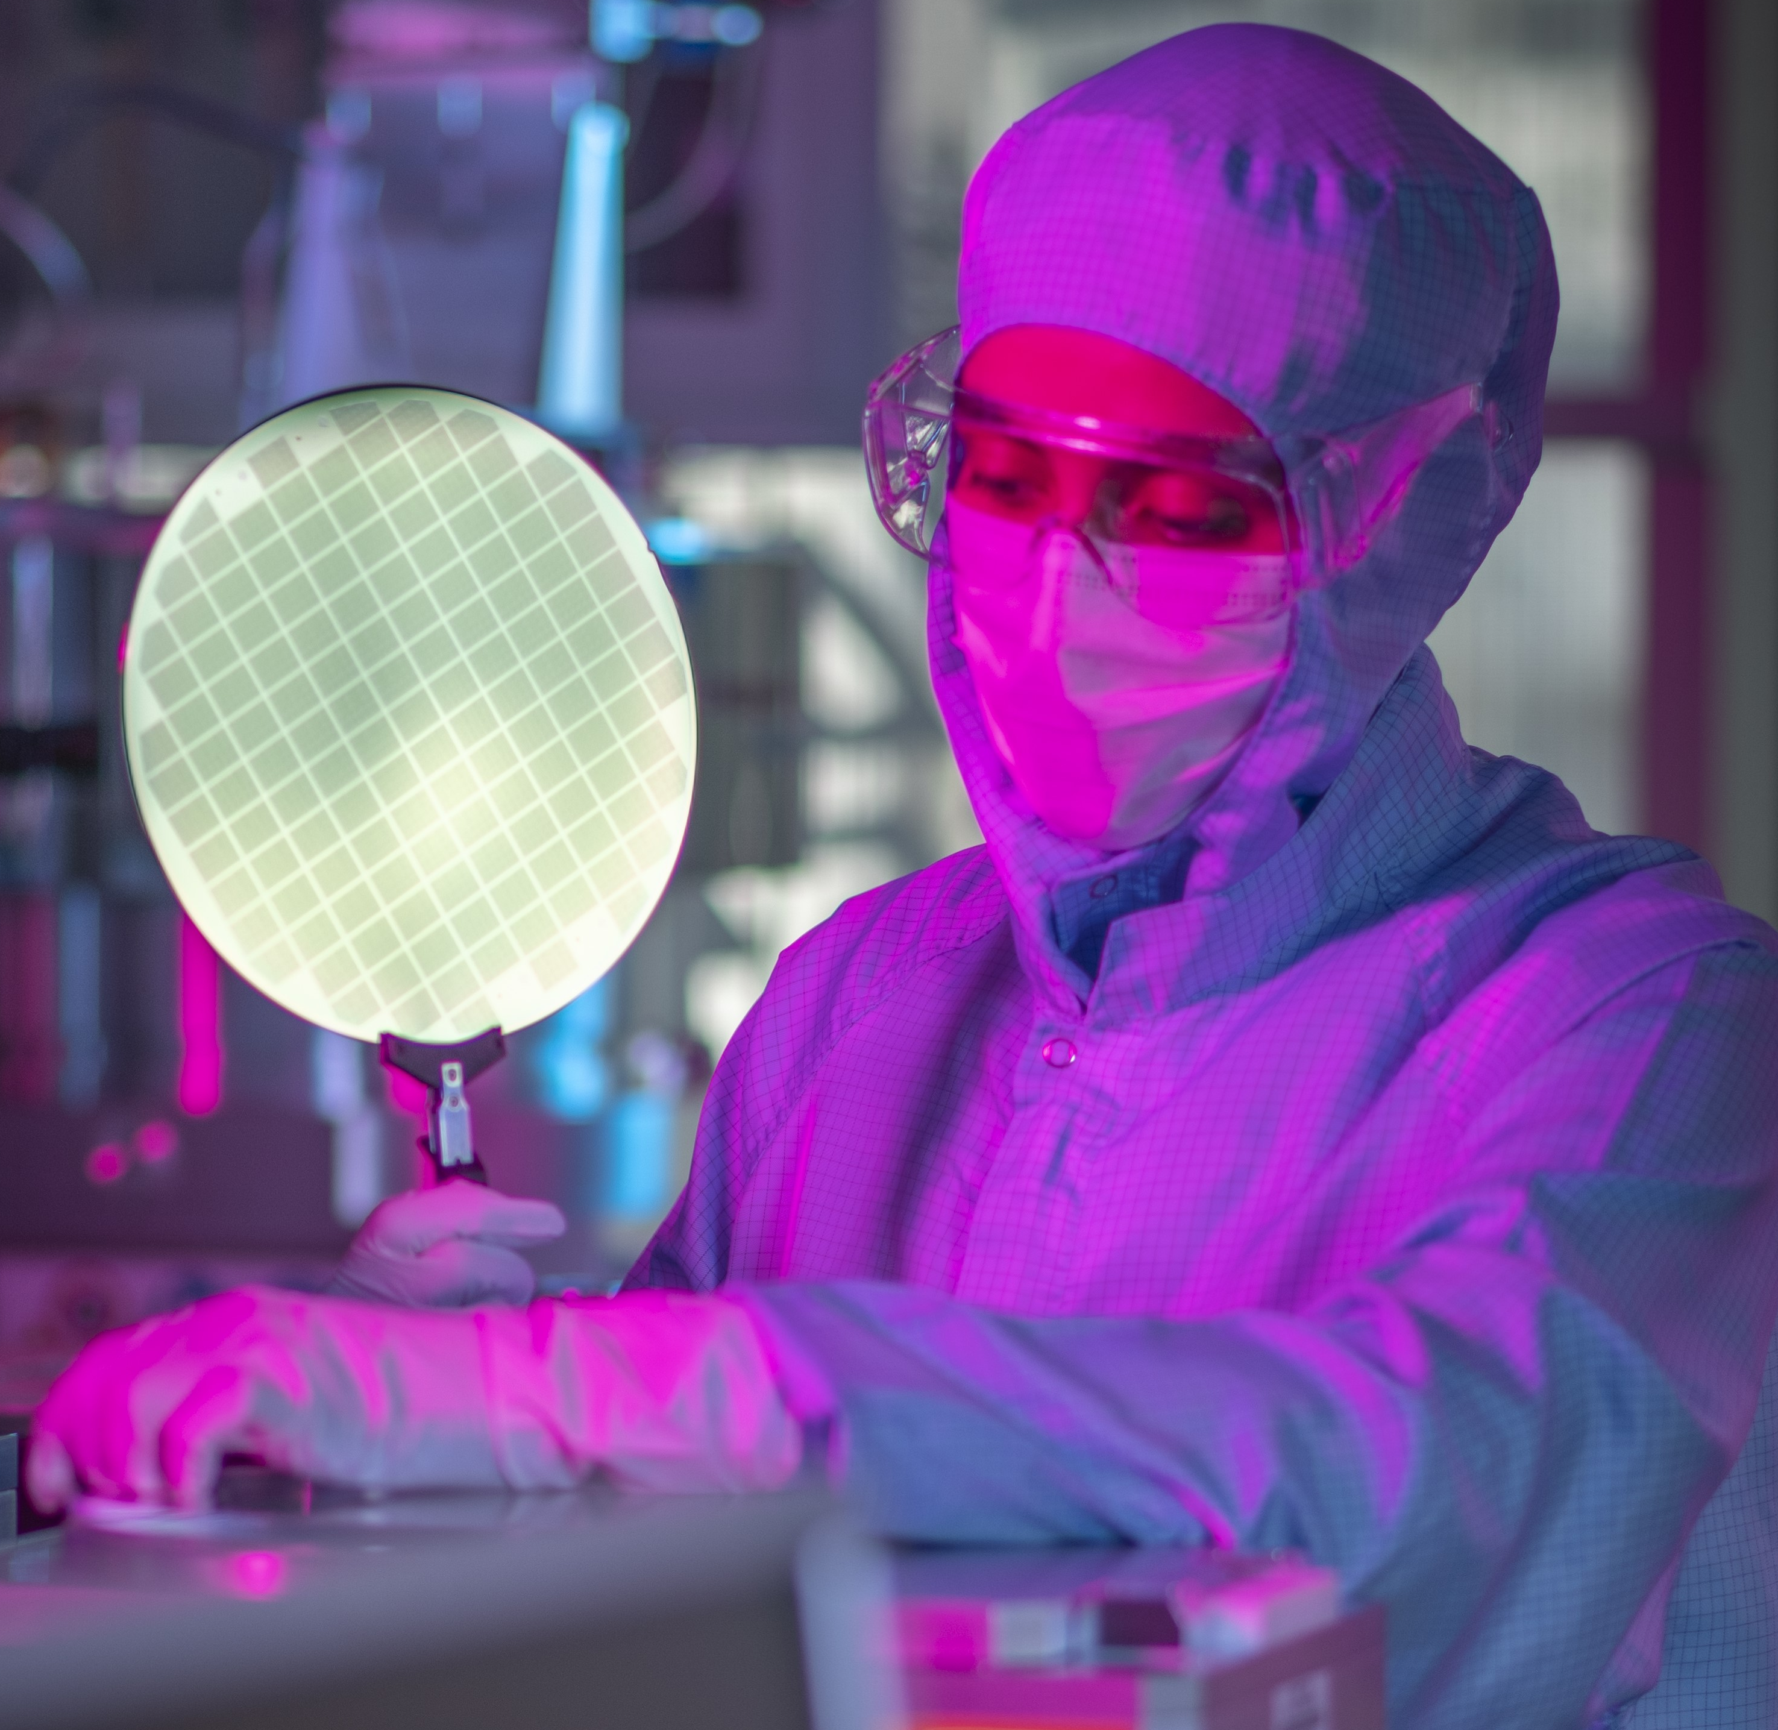
Commercialisation
Mission
To provide the necessary support to establish and enable silicon photonics-enabled companies to progress the technology, manufacturing and market readiness of their solutions.
Vision: To build a pipeline of silicon photonics-enabled companies serving multiple industry sectors by 2030.
Aim
To deliver an environment that will enable organisations to accelerate the development of silicon photonics technology from the research domain through to scale-up.
Approach
Technology roadmap development, connecting researchers to applications
Start up support and structured acceleration programme for academic entrepreneurs
Funding for technology and market readiness projects
Subsidised foundry access for UK universities and first-time UK start-ups/SMEs
Establish PIC Bootcamp as our flagship training scheme

Slide 5
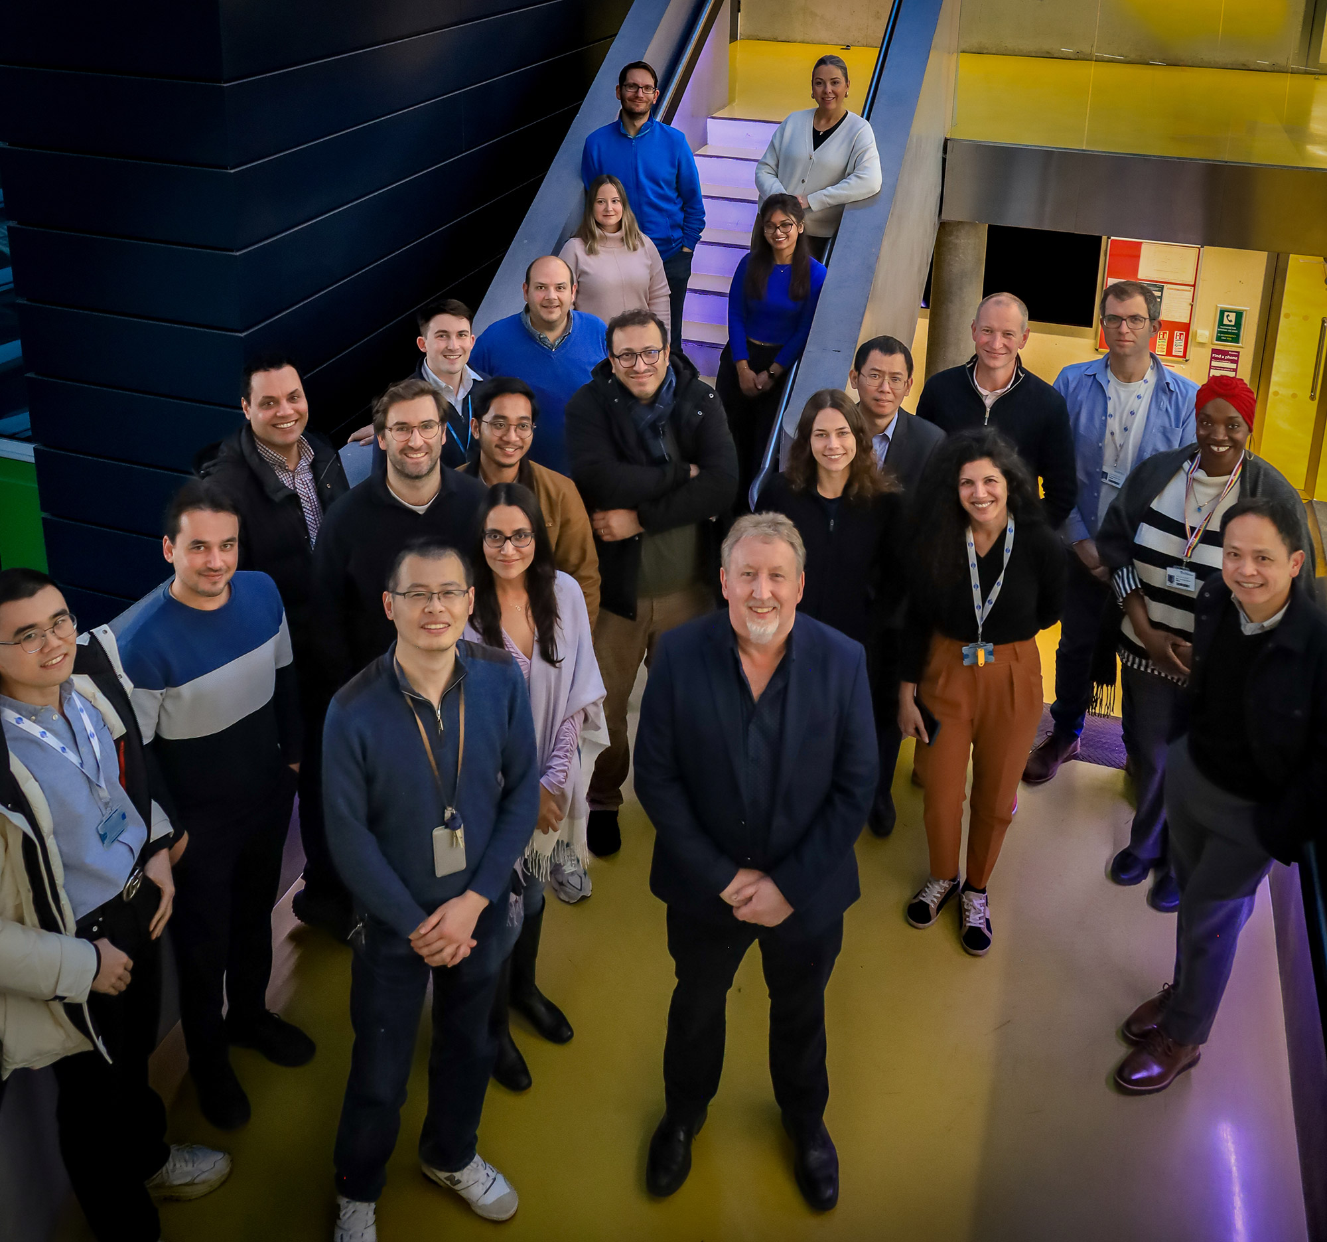
Equality, diversity and inclusion
Mission
To embed EDI in all things we do, so that regardless of protected characteristics, identity or need for special adjustments, all colleagues have equitable access to opportunities, with diverse perspectives invited and valued, and a sense of belonging in a supportive, respectful environment.
Vision: To become the workplace of choice and act as an example to others that teams in more diverse workplaces perform better.
Aims
Improve colleagues’ career and personal development
Improve the balance in engagement with facilities, funding and commercialisation opportunities
Facilitate colleague wellbeing
Active Bystanders to encourage a supportive environment
Approach
Open engagement and co-creation, where appropriate
Process: ensure that processes are readily understood and acknowledged by all colleagues to be fair and transparent
Practice: monitoring, training, communications, professional and personal support

Slide 6

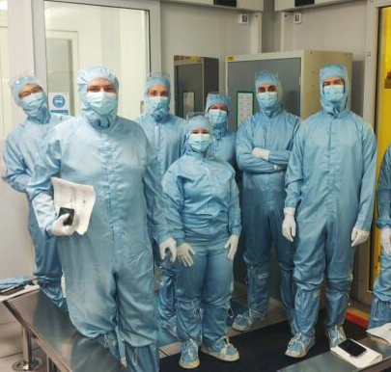
Career development
Mission
To embed a culture of continuous learning and transparent progression, where career development is an intentional, inclusive and strategic function of every team and role.
Vision: To be a beacon of inclusive talent development and a pipeline for leaders in academia and industry.
Aims
Support individual development at all levels
Embed inclusivity and transparency into performance, progression and rewards
Address underrepresentation in leadership and commercialisation
Promote access to networks, mentoring and training
Embed career development planning
Approach
Open engagement and co-creation, where appropriate
Process: ensure that processes are readily understood and acknowledged by all colleagues to be fair and transparent
Practice: monitoring, training, communications, professional and personal support

Slide 7
Responsible Research and Innovation (RRI)
Mission
To deliver our overarching strategy in a sustainable, socially beneficial, economically viable and legally compliant way.
Vision: Ensuring advances in silicon photonics translate into positive societal impact.
Aims
To innovate in ways that meets societal needs and ethical standards, aligned with national and institutional policies, e.g. environmental sustainability, trusted research, research data management and ethics.
Approach
Our RRI efforts are structured around four core pillars:
Sustainable Innovation, Manufacturing and Supply Chain Management
Responsible Data Management and Open Source
Effective and accessible communication
Trusted Research, governance, compliance and financial sustainability

Slide 8
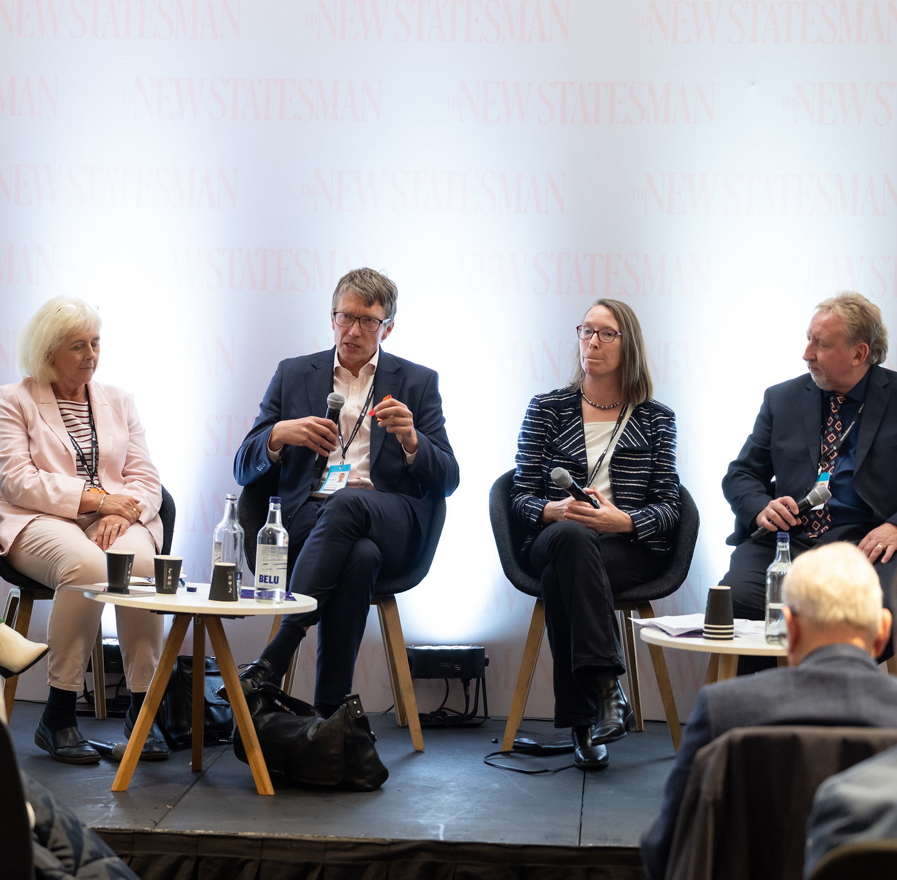
Communications
Vision: For key audiences to understand that the time is right for UK SiPh and why C-PIC is central to its success.
Mission
To support the creation of the pipeline by disseminating C-PIC’s core ethos into relatable and concrete messages, targeted to socially and technically diverse audiences.
Aims
Increase visibility and knowledge of SiPh, C-PIC capabilities and initiatives
Generate leads and convert into C-PIC members
Develop a community of advocates for SiPh and C-PIC
Establish thought leadership
Engage and attract a diverse talent pool
Approach
Data driven, analytical approach including:
Situation and market analysis
Segmentation and targeting of sector specific messaging to resonate with different key audiences
Reporting and measuring of outcomes

